Slide 1

Linear regression
Hiba Achiche
Oussema Mabrouk
3LT3

Slide 2
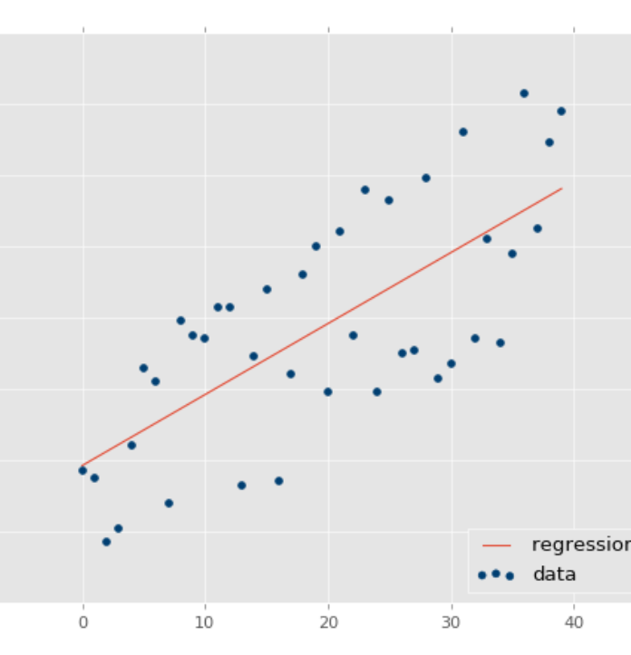
Definition:
Linear regression performs the task to predict a dependent variable value (y) based on a given independent variable (x). So, this regression technique finds out a linear relationship between x (input) and y(output). Linear regression gives us a straight line that best fits the data points.

Slide 3
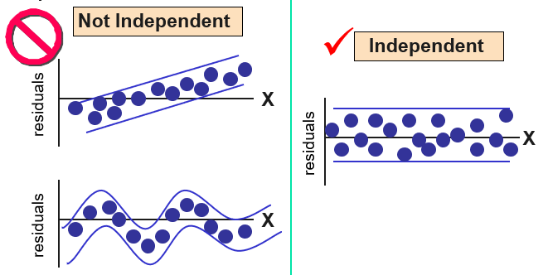
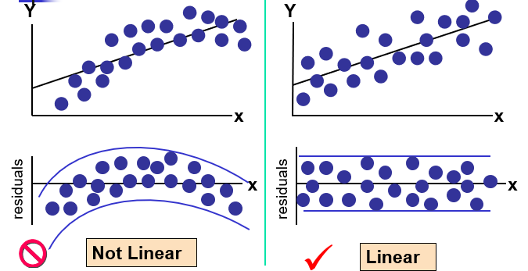
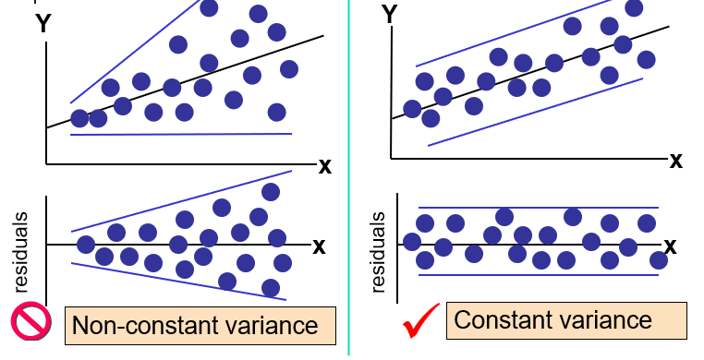
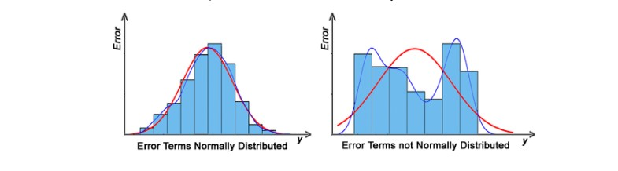
Assumptions of Linear Regression
1. Linearity of residuals:
2. Independence of residuals:
3. Normal distribution of residuals:
4. The equal variance of residuals:
Notes:
Linearity of residuals: There needs to be a linear relationship between the dependent variable and independent variable(s).
2. Independence of residuals: The error terms should not be dependent on one another (like in time-series data wherein the next value is dependent on the previous one). There should be no correlation between the residual terms. The absence of this phenomenon is known as Autocorrelation.
3. Normal distribution of residuals: The mean of residuals should follow a normal distribution with a mean equal to zero or close to zero. This is done in order to check whether the selected line is actually the line of best fit or not.
4. The equal variance of residuals: The error terms must have constant variance. This phenomenon is known as Homoscedasticity.
The presence of non-constant variance in the error terms is referred to as Heteroscedasticity. Generally, non-constant variance arises in the presence of outliers or extreme leverage values

Slide 4
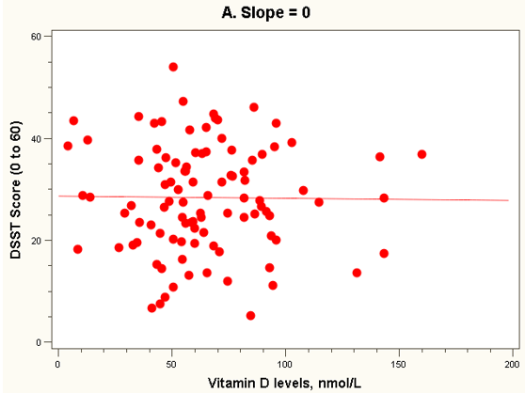
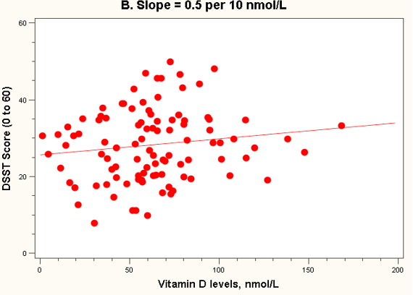
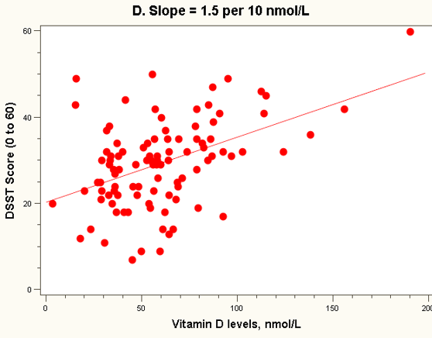
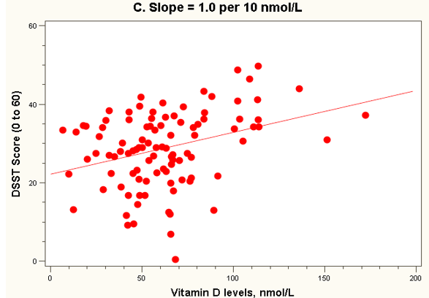
Four hypothetical datasets:
no relationship
weak relationship
weak to moderate relationship
moderate relationship

Slide 5
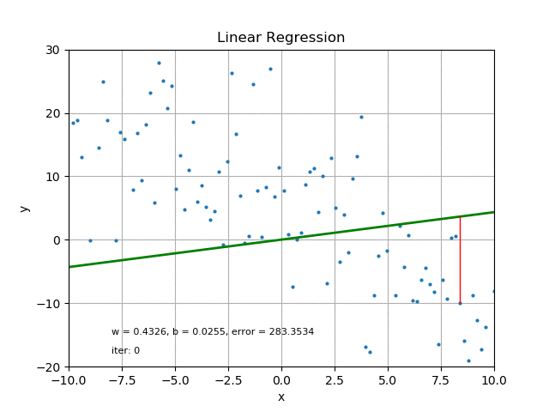
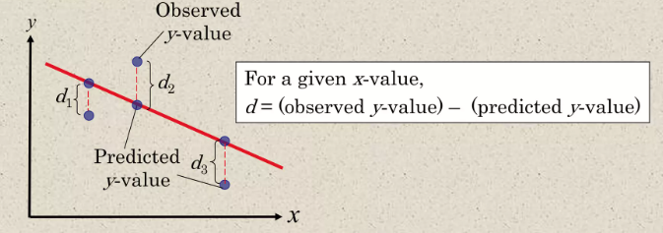
Residuals:
next we will determine the equation of the line that can be used to predict the value of y for a given value of x.
Each data point d; represents the difference between the observed y-value and the predicted y-value for a given x- value on the line. These differences are called residuals.

Slide 6
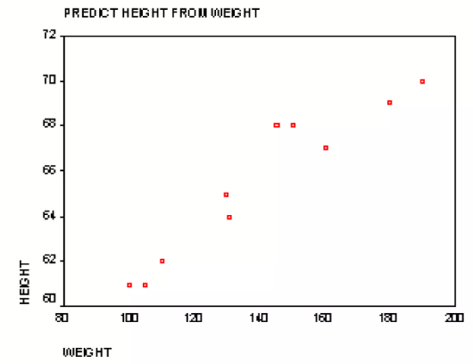
Example:
Imagine you have information about the height and weight of ten people. You can create a graph with weight on one side and height on the other. If height and weight are perfectly related, all points on the graph would make a straight line. However, in real life, this rarely happens. If there is a (nonperfect) linear relationship between height and weight, then you would get a cluster of points on the graph which slopes upward.
Basically, heavier people tend to be taller than lighter ones.

Slide 7


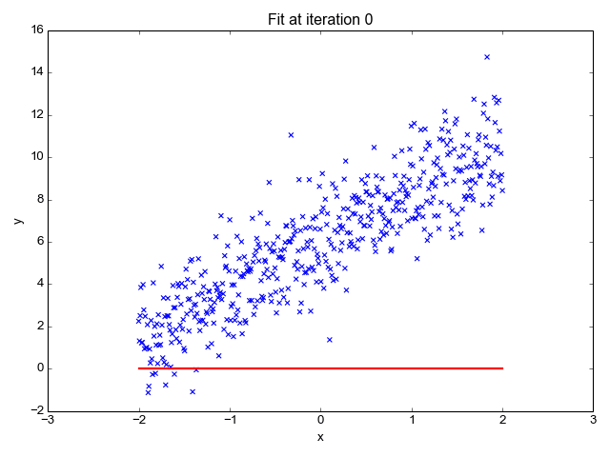

Regression Line
The equation of regression line is where:
m is the slope of the line:
And b is the y-intersept:
Note:

Slide 8
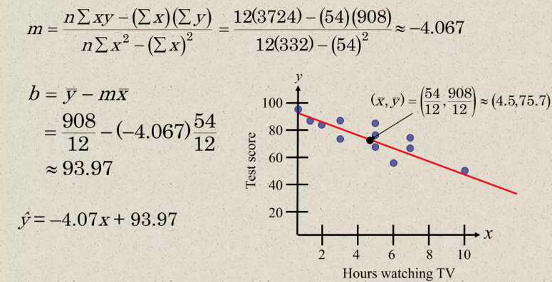
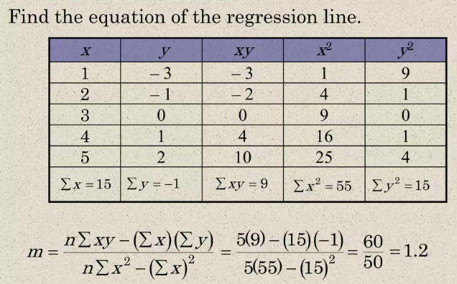
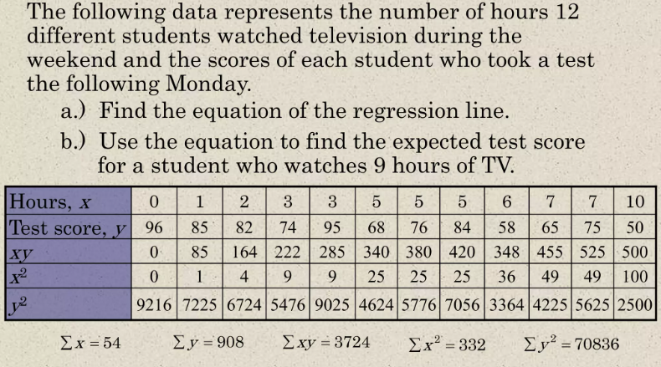
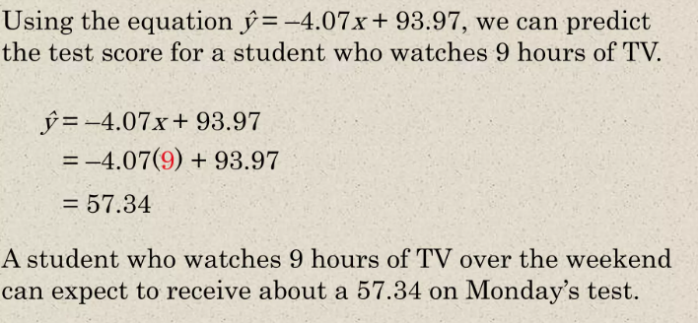
Example:
Notes:
Here we have an example of a dateset of the test score of student based on there time watching TV ,
By applying the rules of linear regression, we can find the slope (m) and y-intercept (b) to create an equation (y)
Then we draw the corresponding line on the curve

Slide 9
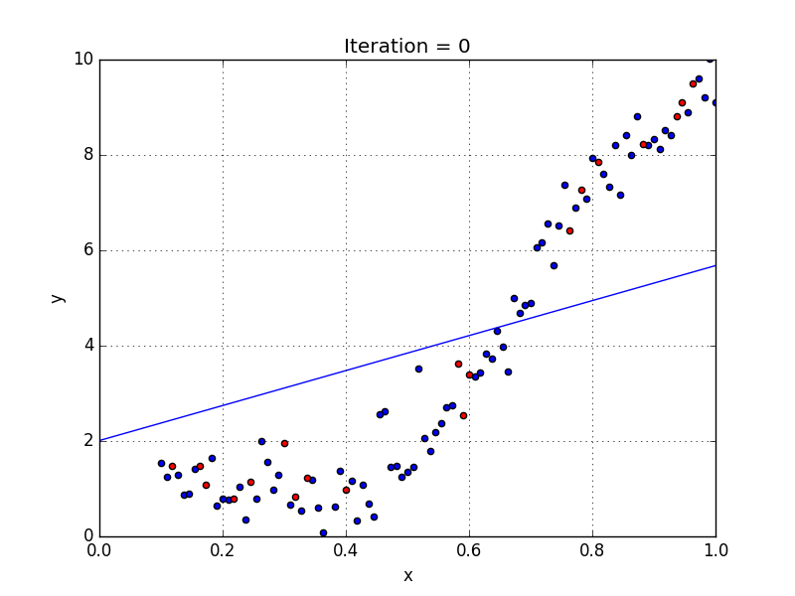
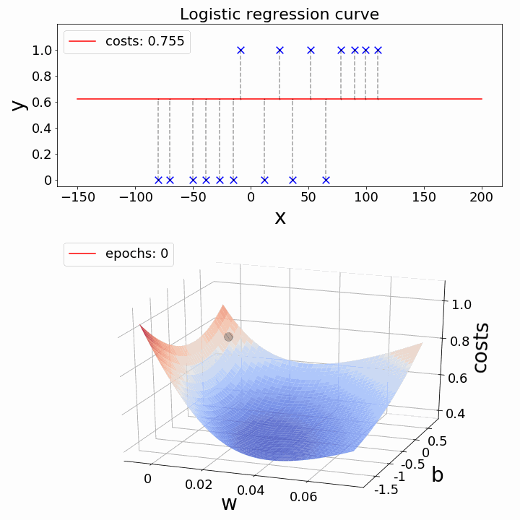
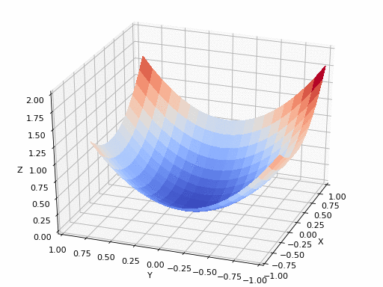
Difference between linear and logistic regression
Output Type:
  Linear regression predicts a continuous numerical output, while logistic regression predicts the probability of an observation belonging to a particular category, yielding a binary (0 or 1) outcome.
Use Case:
  Linear regression is suitable for regression tasks, modeling relationships between variables, whereas logistic regression is used for binary classification tasks, predicting the likelihood of an observation falling into one of two classes

Slide 10
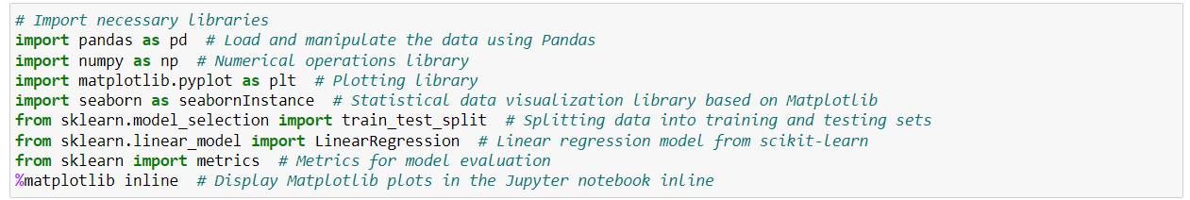
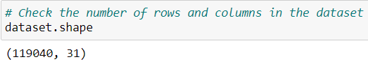
Coding part:
Notes:
Now let’s move on to coding part
Here we will use dataset that contain features of the weather in order to analyze the relationship between two numerical variables: minimum temperature (MinTemp) and maximum temperature (MaxTemp)

Slide 11
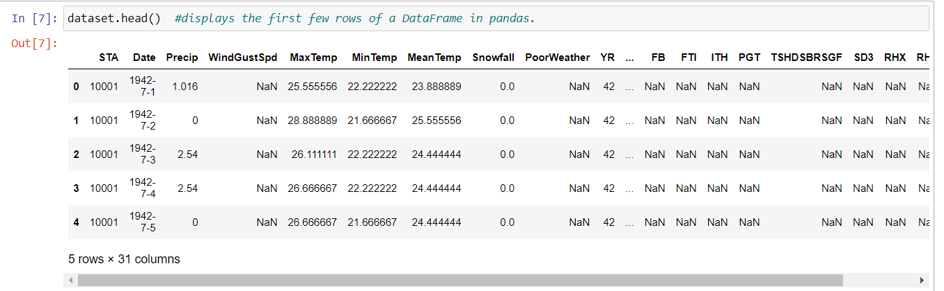
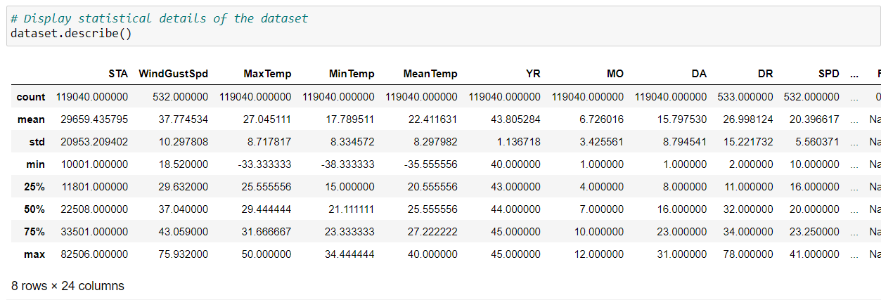

Slide 12
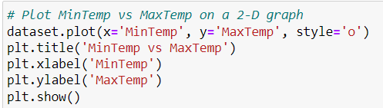
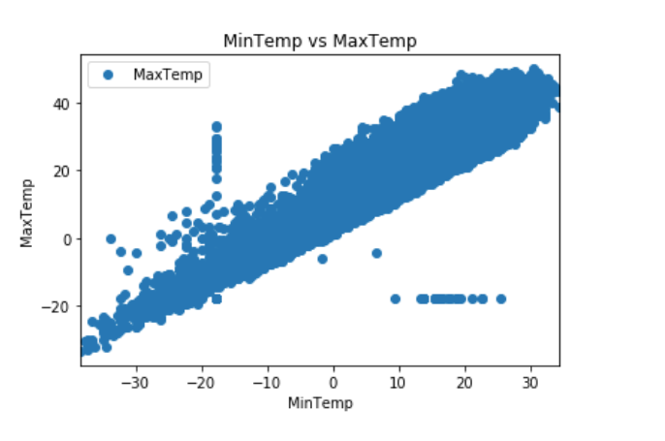
Notes:
The scatter plot suggests a positive linear correlation between minimum temperature (MinTemp) and maximum temperature (MaxTemp).

Slide 13
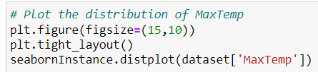
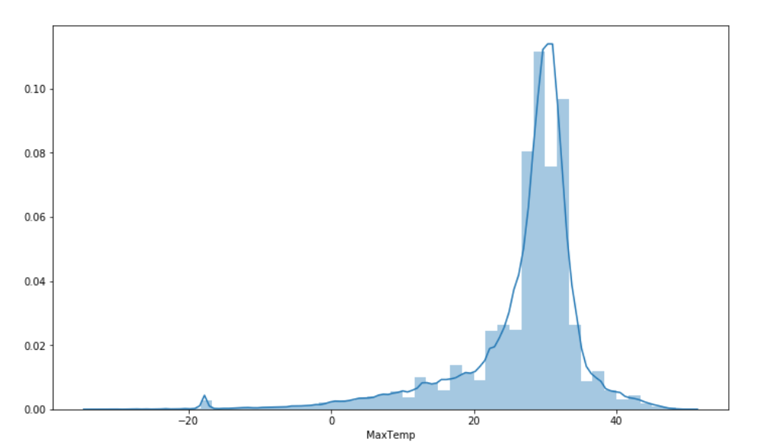
Let’s check the average max temperature and once we plot it we can observe that the Average Maximum Temperature is Between Nearly 25 and 35.
Notes:
This is a contextual information to understand the typical or central tendency of the target variable (maximum temperature) in the dataset.

Slide 14

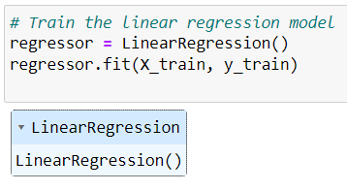
This is the time to train our algorithm.

Slide 15
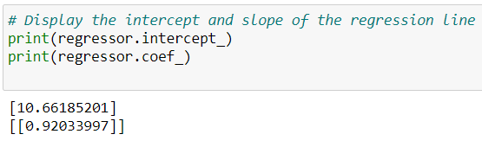

As we have discussed that the linear regression model basically finds the best value for the intercept and slope, which results in a line that best fits the data
Now that we have trained our algorithm, it’s time to make some predictions.

Slide 16
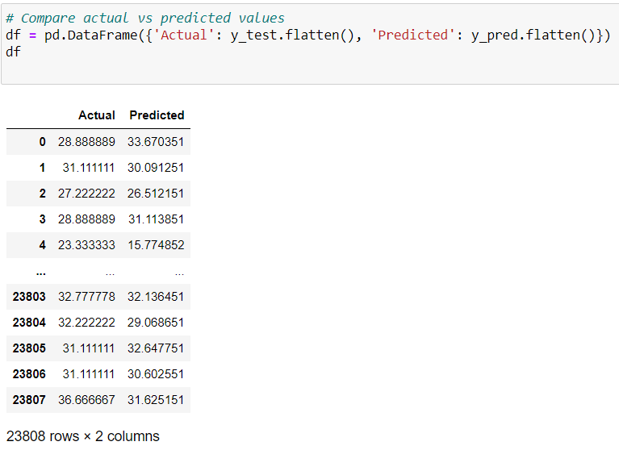
Now compare the actual output values for X_test with the predicted values, execute the following script:
Notes:
The DataFrame df is created to compare and display the actual values (Actual) and the predicted values (Predicted) obtained from the linear regression model on the test set

Slide 17
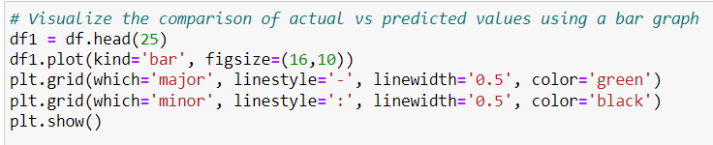
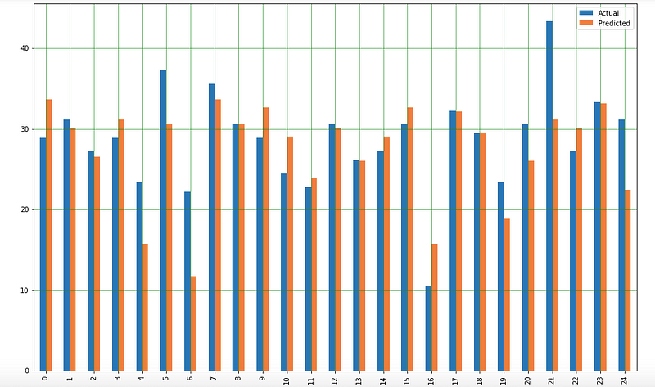
We can also visualize comparison result as a bar graph using the below script :

Slide 18
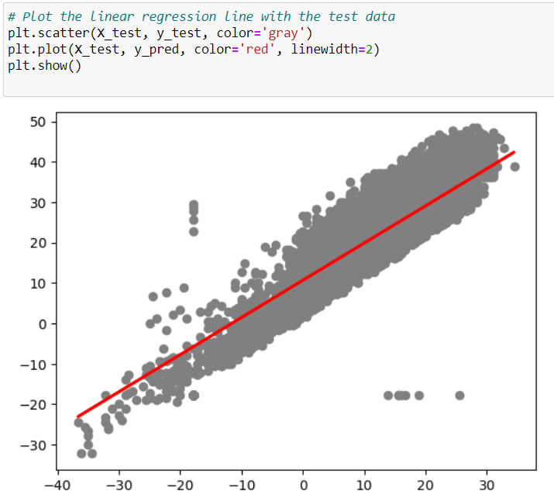
Let's plot our straight line with the test data :
Notes:
We draw the Straight line that best fit the data points

Slide 19


